Slide 1
Excel 101
Mastering the Essentials of Microsoft Excel
Prepared by: Lee
Notes:
0

Slide 2
EXCEL 101 AGENDA
1
4
What is Excel?
Key Lookup Functions
Brief Excel explanation.
Essentials for searching, retrieving, and matching data from tables and ranges
2
5
Why use Excel?
Pivot Table
Highlights the benefits of Excel.
How to create simple Pivot Table
3
Basic Excel Formulas
Discussion of some formulas in Excel
1
Copyright © 2025 WNS (Holdings) Ltd. All rights reserved.

Slide 3

What is Excel?
Excel is a spreadsheet program used for organizing, analyzing, and managing data, and is part of the Microsoft Office suite.
🔍Key Features:
Spreadsheets: Organizes data in rows and columns.
Formulas & Functions: Automates calculations (e.g., SUM, AVERAGE).
Charts & Graphs: Turns data into visuals like bar or pie charts.
Data Tools: Includes sorting, filtering, and pivot tables for deeper analysis.

Slide 4
Why use Excel?
Excel has its ability to perform calculations, create charts, and manage large datasets.
💼 Common Uses:
Easy Data Organization
Quickly store, sort, and manage large amounts of data.
Use rows, columns, and sheets for structured information.
Powerful Calculations
Perform automatic math using formulas.
Built-in functions like SUM, AVERAGE, IF, and more.
Data Analysis Tools
Filter, sort, and use PivotTables for in-depth insights.
Identify trends and patterns easily.
Visual Data Representation
Create charts and graphs to make data easier to understand.
Customize visuals for reports and presentations.
Time-Saving Features
Use templates, formulas, and shortcuts to work faster.
Automate repetitive tasks with macros.
Versatile for Any Task
Budget tracking, attendance logs, reports, scheduling, and more.

Slide 5
Basic Excel Formulas
Here are Excel formula examples for us to get started:
1. SUMIFS (Add Values)
Adds numbers in a range, but only if they meet multiple conditions.
Syntax:
=SUMIFS(sum_range, criteria_range1, criteria1, [criteria_range2, criteria2], …)

Slide 6
Basic Excel Formulas
2. COUNTIFS
COUNTIFS counts the number of cells that meet multiple conditions. It’s like SUMIFS, but instead of summing values, it counts matching entries. If you only need one condition, use COUNTIF.
Syntax:
=COUNTIFS(criteria_range1, criteria1, [criteria_range2, criteria2], …)

Slide 7
Basic Excel Formulas
2. AVERAGEIFS
The AVERAGEIFS function returns the average (mean) of cells that meet one or more criteria.
Syntax:
=AVERAGEIFS(average_range, criteria_range1, criteria1, [criteria_range2, criteria2], …)

Slide 8
Basic Excel Formulas
7. IF (Logical Test)
The IF function is often used when you want to sort your data according to a given logic. The best part of the IF formula is that you can embed formulas and functions in it.
=IF(logical_test, [value_if_true], [value_if_false])
Example:
=IF(C2<D3,“TRUE”,”FALSE”) – Checks if the value at C3 is less than the value at D3. If the logic is true, let the cell value be TRUE, otherwise, FALSE

Slide 9
Basic Excel Formulas
8. IF (AND)
The IF(AND) formula in Excel is used when you want to test multiple conditions at once and return one result if all of them are true, and another result if any is false.
=IF(AND(condition1, condition2), value_if_true, value_if_false)
How it works:
AND(condition1, condition2, ...) checks if all conditions are TRUE.
If all conditions are TRUE → value_if_true is returned.
If any condition is FALSE → value_if_false is returned.
Example:
=IF(AND(A1>=50, B1>=50), "Pass", "Fail")
If A1 is at least 50 and B1 is at least 50, result is "Pass".
Otherwise, result is "Fail".

Slide 10
Basic Excel Formulas
9. IF (OR)
The IF(OR) formula in Excel is used when you want to test multiple conditions and return one result if at least one condition is true, and another result if all are false.
=IF(OR(condition1, condition2), value_if_true, value_if_false)
How it works:
OR(condition1, condition2) checks if any of the listed conditions is TRUE.
If at least one condition is TRUE → value_if_true is returned.
If all conditions are FALSE → value_if_false is returned.
Example:
=IF(OR(A1>=50, B1>=50), "Pass", "Fail")
If A1 is at least 50 or B1 is at least 50, result is "Pass".
If both are below 50, result is "Fail".

Slide 11

Key Lookup Functions in Excel
1. VLOOKUP (Vertical Lookup)
VLOOKUP stands for Vertical Lookup. It searches for a value in the first column of a table and returns a value from a specified column to the right of it. It’s one of the most commonly used lookup functions in Excel.
VLOOKUP Syntax:
=VLOOKUP(lookup_value, table_array, col_index_num, [range_lookup])
Arguments Explained:
lookup_value: The value you want to find.
table_array: The range that contains the data (must include the lookup column as the first column).
col_index_num: The column number in the table from which to return the value.
range_lookup (optional):
TRUE = Approximate match (default)
FALSE = Exact match

Slide 12
Key Lookup Functions in Excel
2. HLOOKUP (Horizontal Lookup)
HLOOKUP is similar to VLOOKUP but searches horizontally across the first row of a range.
HLOOKUP Syntax:
=HLOOKUP(lookup_value, table_array, row_index_num, [range_lookup])
Arguments Explained:
lookup_value → The value you want to search for in the first row.
table_array → The range of cells containing the data.
row_index_num → The row number (within the table_array) to return the value from.
Example: 2 means the second row of the range.
[range_lookup] → Optional:
TRUE (default) = Approximate match
FALSE = Exact match only

Slide 13
Key Lookup Functions in Excel
3. INDEX-MATCH (Flexible Bidirectional Lookups)
Unlike VLOOKUP, the INDEX-MATCH combination allows for lookups in any direction, making it ideal for multi-dimensional models.
INDEX Function - Returns the value of a cell at the intersection of a row and column in a given range.
=INDEX(array, row_num, [column_num])
MATCH Function - Returns the position of a lookup value in a range.
=MATCH(lookup_value, lookup_array, [match_type])

Slide 14
Key Lookup Functions in Excel
4. XLOOKUP (Advanced Lookups)
XLOOKUP removes the limitations of VLOOKUP and INDEX-MATCH by supporting bidirectional lookups, dynamic array returns, and enhanced error handling.
XLOOKUP Syntax:
=XLOOKUP(lookup_value, lookup_array, return_array, [if_not_found], [match_mode], [search_mode])
Arguments Explained:
lookup_value – The value you're searching for
lookup_array – The column or row to search in
return_array – The column or row to return data from
[if_not_found] – Optional message/value if not found
[match_mode] – 0 = exact match (default), -1 = exact or next smaller, 1 = exact or next larger, 2 = wildcard
[search_mode] – 1 = first to last (default), -1 = last to first

Slide 15
Pivot Tables in Excel
Pivot tables are one of Excel's most powerful features. A pivot table allows you to extract the significance from a large, detailed data set.
A Pivot Table helps you:
Automatically group and summarize data
Rearrange or "pivot" data to view it from different angles
Quickly find patterns, trends, and insights

Slide 16
Pivot Tables in Excel
What You Can Do with a Pivot Table:
Sum total sales per region
Count how many times something occurs
Average agent AHT per week
Compare values across different time periods or categories
Filter to focus on specific data points

Slide 17
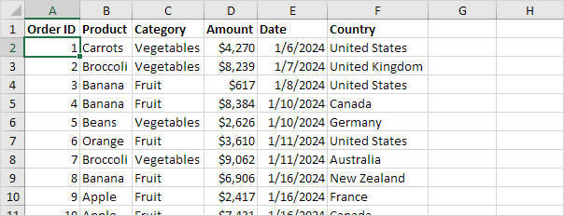
How to Create a Pivot Table in Excel:
1. Select your data range.
Example:
Our data set consists of 213 records and 6 fields. Order ID, Product, Category, Amount, Date and Country.

Slide 18
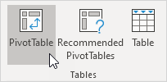
How to Create a Pivot Table in Excel:
2. Go to Insert > PivotTable.
To insert a pivot table, execute the following steps.
Click any single cell inside the data set.
On the Insert tab, in the Tables group, click PivotTable.
The following dialog box appears. Excel automatically selects the data for you. The default location for a new pivot table is New Worksheet. Click OK.

Slide 19
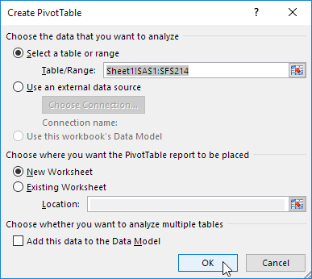
How to Create a Pivot Table in Excel:
3. Choose whether to place the table in a new or existing worksheet. The following dialog box appears. Excel automatically selects the data for you. The default location for a new pivot table is New Worksheet. Click OK.

Slide 20
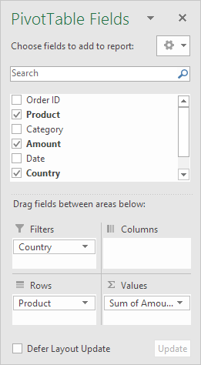
How to Create a Pivot Table in Excel:
4. Drag fields into the Rows, Columns, Values, and Filters sections in the PivotTable Field List.
The PivotTable Fields pane appears. To get the total amount exported of each product, drag the following fields to the different areas.
1. Product field to the Rows area.
2. Amount field to the Values area.
3. Country field to the Filters area.

Slide 21
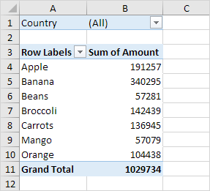
How to Create a Pivot Table in Excel:
Here is the sample outcome of the Pivot Table. Bananas are our main export product. That is how easy pivot tables can be.

Slide 22
Thank you!

